Slide 1
Capstone Project Phase 1
Breast cancer cells classification using CNN
Supervisor: Ronen Zilber Students: Shenhav Hezi, Tomer Boyanjo

Slide 2
Table of Contents
Introduction
Breast cancer as of today
Motivation
Approach to solution
CNN
DenseNet
Inception V4
Datasets:
BreakHis
RSNA
Researched hyperparameters
Diagrams
GUI
Evaluation
2

Slide 3
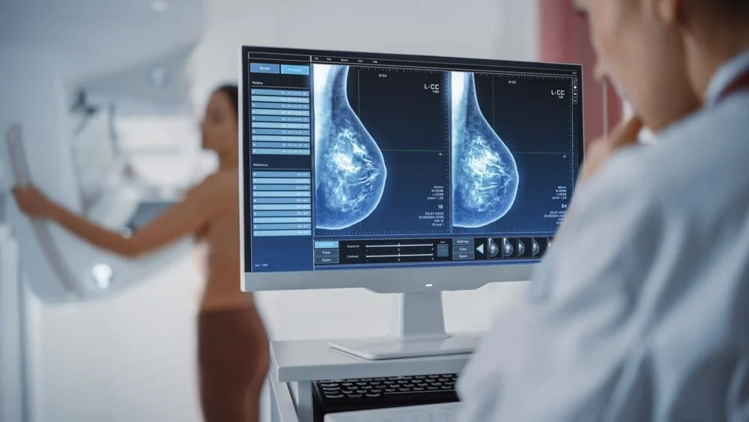
breast cancer cells classification using CNN on histopathology and mammography imaging - Introduction
Breast cancer is the second most diagnosed cancer worldwide. Breast cancer occurs in four main types: normal, benign, in-situ cancer and invasive cancer.
Notes:
Benign = not danger but have a chance in future to be a breast cancer.
In-situ cancer = cancer cells that not spread out yet.
Invasive carcinoma = cancer cells which spread out to another parts of the breasts.

Slide 4
breast cancer cells classification using CNN on histopathology and mammography imaging - Introduction
Breast cancer can be diagnosed using several approaches, two of them:
Histopathology images, which are microscopic images of breast tissue that are extremely useful in early treatment of the cancer.
Mammography which is specialized medical imaging that uses a low-dose x-ray system to see inside the breasts. A mammography exam, called a mammogram, aids in the early detection and diagnosis of breast diseases in women.

Slide 5
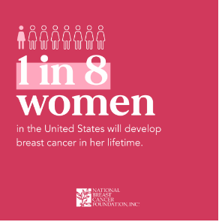
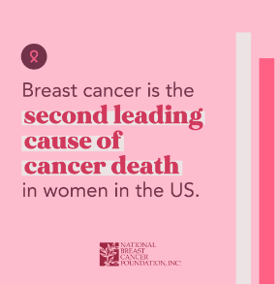
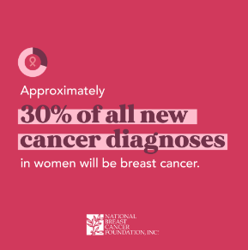
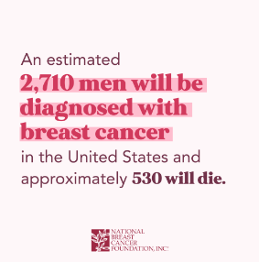
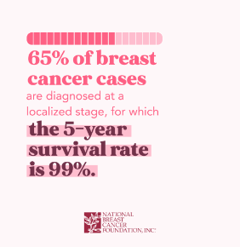
Breast cancer as of today

Slide 6
Motivation
There are places and countries where there is shortage of specialist doctors, and patients cannot get results of test to find whether they have breast cancer quickly enough which can worsen survivability rates for them. Early detection using automated classification tool can bring about these aspects:
earlier detection can drastically improve the patient's survival chances.
waiting time for a diagnosis will be reduced and patient can get treatment earlier.
When there is lack of specialist doctors, these tools can help serve as secondary opinions
6

Slide 7
Approach to solution
we expect to build a system that classify if a patient has breast cancer based on mammography and histopathological imaging with higher accuracy than the automatic classifications of today.
System of urgency in patients using our system.
Our technology.
7
Notes:
In places where there is shortage of specialist doctors, our system classify both on mammography and histopathology as at risk for cancer, and the patient will be considered more urgent for diagnose of a specialist doctor.
We will use the BreakHis (Histopathology) and RSNA Screening mammography dataset to research 2 CNN architectures (DenseNet, Inception V4) while testing different hyperparameters to maximize our accuracy of breast cancer detection.

Slide 8
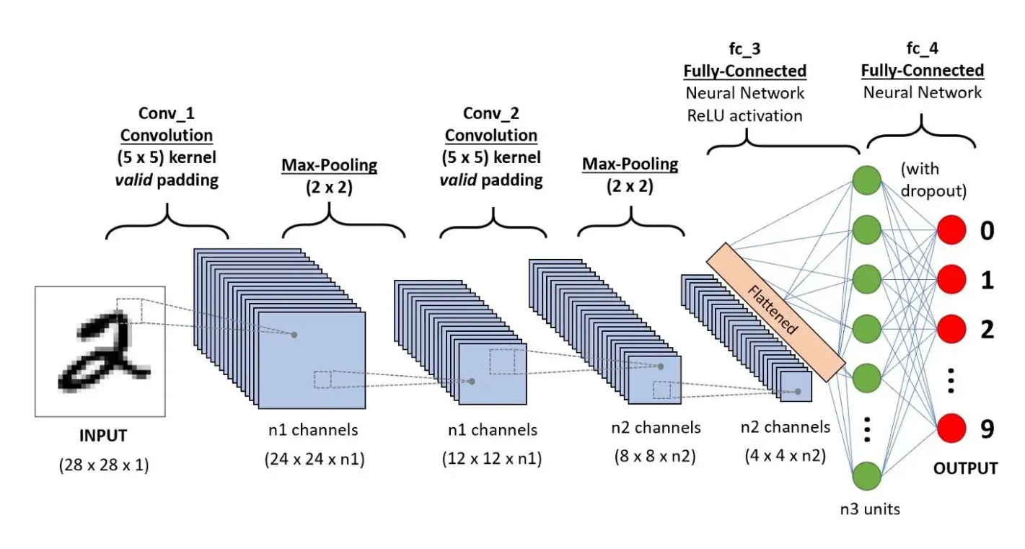
CNN
Convolutional neural networks are a specialized type of artificial neural networks that use a mathematical operation called convolution.
There are usually 3 types of layers in CNNs:
convolution layer
pooling layers
fully connected layer
8
Notes:
convolution layer - Its purpose is to extract features from the image. applying a filter on an input, passing the result to the next layer (feature maps).
pooling layers – Pooling layers reduce the dimensions of data by combining the outputs of neuron clusters at one layer into a single neuron in the next layer.
fully connected layer - maps the extracted features into final output, They come as the last layers after convolution and pooling and these layers take the output of previous layers to classify the output.

Slide 9
DenseNet
DenseNet is a convolutional neural network architecture that connects each layer to every other layer in a feed-forward fashion.
This architecture is designed to alleviate the vanishing-gradient problem encountered in traditional deep neural networks.
DenseNet can be very deep, with hundreds of layers, and still be able to train effectively.
9
Notes:
This architecture is designed to alleviate the vanishing-gradient problem encountered in traditional deep neural networks, by using direct connections between layers, rather than stacking layers sequentially.
DenseNet can be very deep, with hundreds of layers, and still be able to train effectively, We will use the DensenNet 121 which is one of the smaller DenseNet architectures contains 4 dense blocks each containing a fixed number of layers.

Slide 10
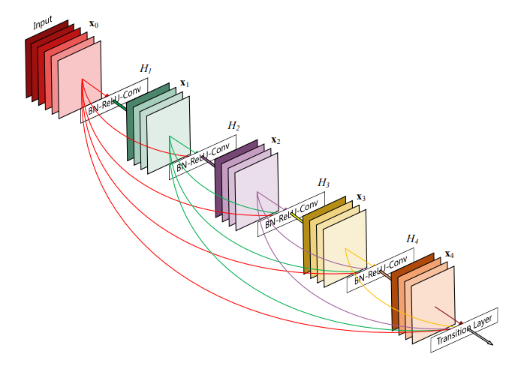
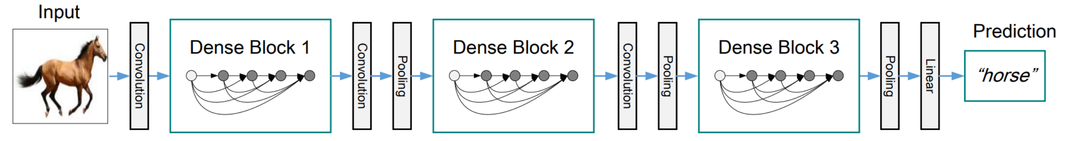
Uses of the DenseNet today
DenseNet 121 was introduced in the original DenseNet paper and has been shown to achieve good performance on several benchmark datasets and is a good way to do tasks where computational resources are limited.
Source: Densely Connected Convolutional Networks original paper.
10

Slide 11
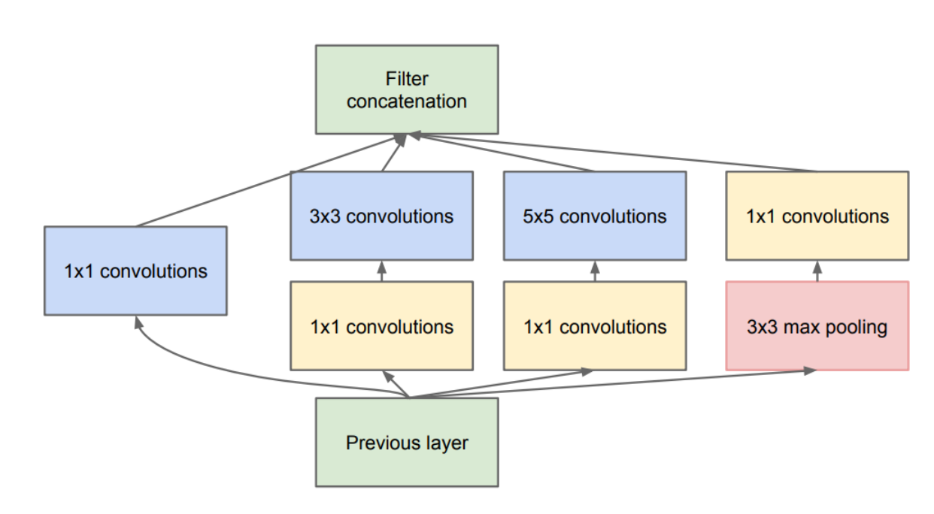
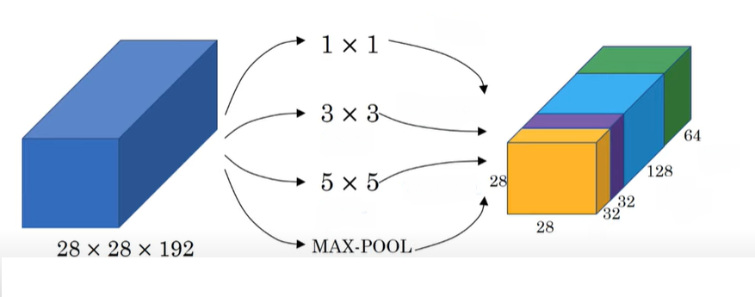
Inception V4
The inception network which was introduced as Googlenet in 2014 takes a new approach to deep layers models where before different types of convolutions and pooling layers were stacked upon each other but now in an inception module we combine within the same layer different convolutions and a pooling.
11

Slide 12
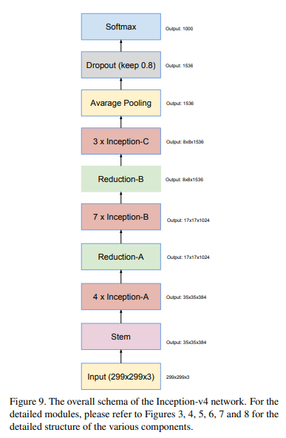
Inception V4
inception v4 is an updated and fined tuned version of inception.
12

Slide 13
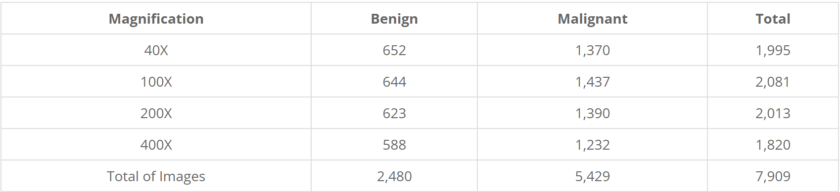
BreakHis
The Breast Cancer Histopathological Image Classification (BreakHis) composed of:
7,909 microscopic images of breast tumor tissue collected from 82 patients using different magnifying factors (40X, 100X, 200X, and 400X).
2,480 benign
5,429 malignant samples (700X460 pixels, 3-channel RGB, 8-bit depth in each channel, PNG format for both benign and malignant images).
The BreaKHis is structured as follows:

Slide 14
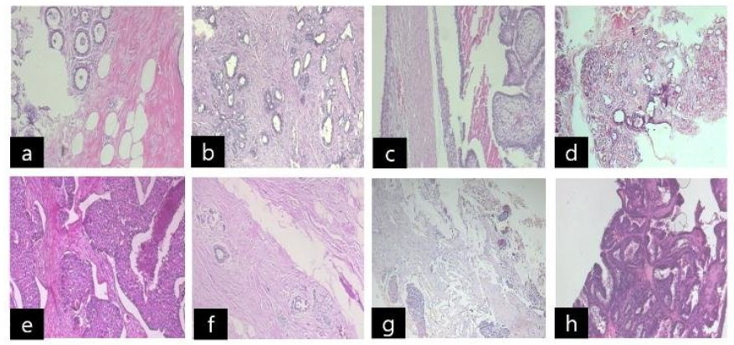
BreakHis
BreakHis dataset composed of benign and malignant images : benign [(a) : adenosis, (b) : fibroadenoma, (c) : phyllodes tumor, (d) : tubular adenoma], malignant [(e) : ductal carcinoma, (f) : lobular carcinoma, (g) : mucinous carcinoma, (h) : papillary carcinoma]
Source: https://www.researchgate.net/figure/BreakHis-dataset-composed-of-benign-and-malignant-images-benign-a-adenosis-b_fig2_327528970
14

Slide 15
RSNA
Radiological Society of North America (RSNA) Screening mammography breast cancer detection dataset composed of:
54713 files
size of 314.72gb
roughly 8,000 patients in the hidden test set (there are usually but not always 4 images per patient).
Contains the following labels:
cancer - Whether or not the breast was positive for malignant cancer.
invasive - If the breast is positive for cancer, whether or not the cancer proved to be invasive.
15

Slide 16
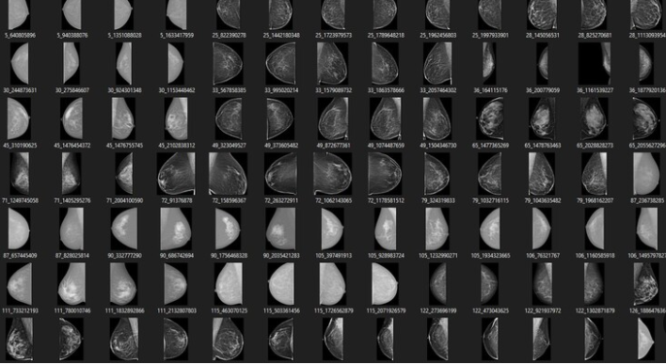
RSNA
16

Slide 17
Researched hyperparameters
Learning rate {0.1 – 0.000001}, learning rate determines the step size at each iteration while moving toward a minimum of a loss function.
Epochs {10, 50, 250}, specifies the number of epochs or full passes of the entire training dataset through the algorithm’s training or learning process.
Batch size {32, 64}, batch size is the number of samples that are passed through the model before the model is updated. The size of a batch must be less than the number of samples in the training dataset.
Dropout {0.2-0.5} Dropout is a technique where randomly selected neurons are ignored during training. They are “dropped out” randomly. Dropout helps combat overfitting of the model
17

Slide 18
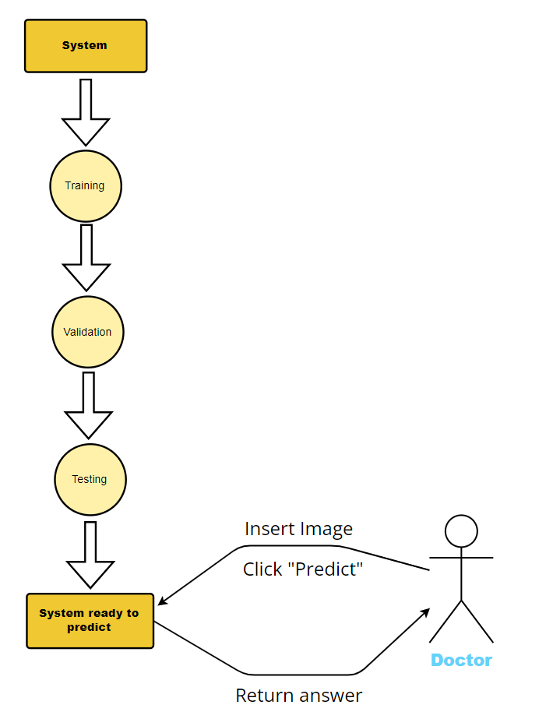
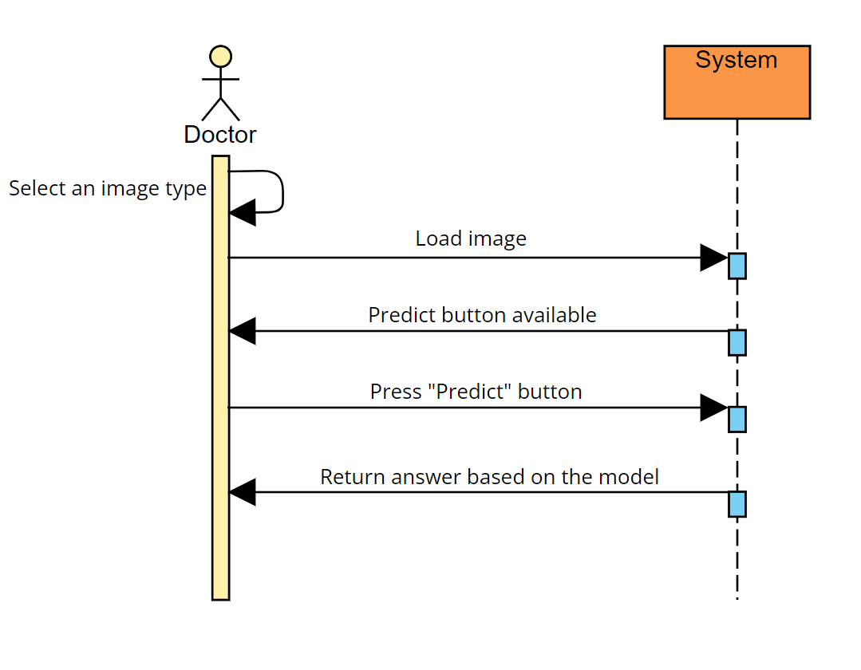
Diagrams
Flowchart diagram:
Sequence diagram:
18

Slide 19
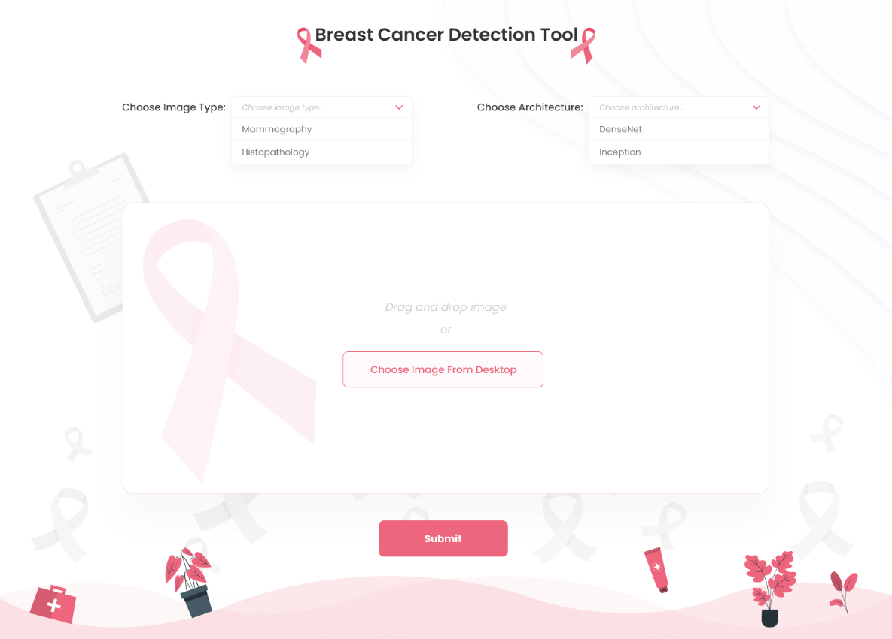
GUI
19

Slide 20
Evaluation
Case | Case test | Result
1 | Trying to predict without an image loaded | Error message: please load image
2 | Load image without choosing image type | Error message: please choose image type
3 | Load wrong image (wrong format) | Error message: wrong format
4 | Load correct image and choose type and architecture | Image will appear on screen
5 | Try to submit with correct image and chosen type and architecture | Result message will appear on screen
6 | Load Image with low resolution | Result message with low predicted percentage
7 | Issue with loading the Image | Error message: Can't load image, please try again
8 | Low predict percentage (93%<) | Warning message: Predicted result is not accurate.
20

Slide 21

21

